Slide 1



Ministry of Education
STUDENT INJURY PREVENTION INITIATIVE

Slide 2
Workshop Objectives:
Common understanding of Ministry expectations by all stakeholders
Results of the Ministry of Labour inspections
  CODE partnership:
    Resources for administrators
    Face to face training for board teams
    E-Learning resources
Ministry of Education actions to address the issues:
  Focus of the funding
  How the funding is allocated to school boards
  Required reporting
  Q’s and A’s

Slide 3


Ministry of Labour Inspections
  Inspectors were asked to visit elementary or secondary schools with science laboratories and those high schools which teach manufacturing technology, construction technology and transportation technology
The initiative helped raised awareness about health and safety and promoted positive changes in the health and safety culture of schools

Slide 4
On January 16, 2013,
MOL released their report on the results of the elementary and secondary school inspections.
Over 6,600 non-compliance orders were issued including 283 ‘stop work’ orders.

Slide 5
Results of the inspections
Between September 2011 and June 30, 2012 inspectors conducted over 1,974 field visits to over 900 workplaces.
(MOL Data)
Combined Statistics Phase 1 and 2:
6,658
Orders in total
5,164 (78%)
time-based orders
283 (4%)
stop work orders
144 (2%)
requirements
6,658
Orders in total
563 (9%)
forthwith orders
153 (2%)
plan based orders

Slide 6
A time-based order, does not present an imminent safety hazard. They specify the time in which an employer must achieve compliance with the order;
A stop work order is issued by an inspector if a violation is found that is of immediate danger to a worker’s health and safety. Such an order eliminates the worker’s exposure to the hazard by generally requiring a piece of equipment or process not to be used until the violation is corrected;
Forthwith order- efforts to achieve compliance must begin immediately and be completed before the inspector leaves.

Slide 7
The top health and safety concerns found in the 181 orders issued under 25 (2)(h) were:
  guarding/shielding (64% or 116 orders),
  lifting device (i.e. inspection, weight capacity) (12% or 21 orders),
  hazard of falling (i.e. ladders, guardrails) (8% or 14 orders)
  fire/flammable/explosion (4% or 8 orders),
  maintenance of equipment (2% or 4 orders), and
  personal protective equipment (2% or 4 orders)
  chemical hazards
  eye wash stations/safety showers
  obstructions/poor housekeeping/ maintenance of floors
  material handling and storage

Slide 8
Ministry of Education Funding
In 2012-13 school year EDU provided school boards with $9.9 million in one time funding to:
improve safety plans
address safety issues and environmental concerns
Funding and Reporting
2012-13
2013-14
$9.9M
Funding
7.4M (75%)
2.5M (25%)
Reporting
Reporting due Sept. 30th, 2013 to EDU
Reporting due February 28th, 2014 to EDU
  In August 2013, EDU sent out a memo informing school boards that the 2013-14 funding was sent out as part of their SHSM funding.

Slide 9
Project Objectives
This one-time funding is intended to support boards in addressing injury prevention in technological education facilities and science labs to ensure that:
  Students have access to the broadest range of hands-on learning experiences in their technological education facilities and science labs using safe equipment in risk-free environments
  Boards and schools have an up-to-date health and safety plan
  School staff have a safety mindset and have relevant and current expertise to address injury prevention in technological education facilities and science labs

Slide 10
Ministry of Education Funding
EDU has also provided funding to OCTE and STAO to develop resources for educators to promote health and safety:
1. Ontario Council for Technological Education (OCTE) - $165,000
  OCTELab Project - interactive web-based tools intended for educators to explain and highlight safety in Technological Education curriculum (Phase I and II)
2. Science Teachers’ Association of Ontario (STAO) - $110,000
  Fire Safety Resource – six instructional videos and workshop/training materials intended for educators
  Curriculum Linked Safety materials for demonstrations in a classroom environment

Slide 11
Scope of Project
PART A: a minimum of 35% of the board allocation
These funds are to be used for improvements to board-level safety activities in technological education facilities and science labs. Boards determine areas of local need and will identify timelines for completion of the plan’s components.
  May include:
  Safety inspections
  Multi-year planning
  Professional Development

Slide 12
PART B: a maximum of 65% of the board allocation
Scope of Project
Address safety issues and environmental concerns in technological education facilities and science labs
Safe operation of equipment in technological education and science labs:
Guarding
Ventilation systems
Chemical storage
Eyewash stations

Slide 13
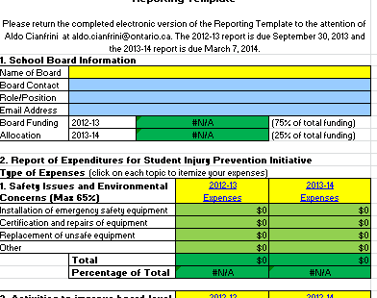

Slide 14
Category A:

Slide 15
Category B:

Slide 16
Category A:

Slide 17
Category B:

Slide 18
Category A:

Slide 19
Category B:

Slide 20
Category A:

Slide 21
Category B:

Slide 22
Category A:

Slide 23
Category B:

Slide 24
Category A:

Slide 25
Category B:

Slide 26


Allocated funding cannot be used for:
Capital IT purchases including computers or other related hardware
General school property maintenance including building repairs and related capital expenses such as replacing roofs, windows and boilers.

Slide 27
Is there someone in your board responsible for addressing the results of the recent MOL inspections?
Health and Safety in your Board (i.e. Health and Safety Officer/Manager)
No
Yes
RESULTS FROM
56
School Boards
Notes:
Health and Safety in your Board (i.e. Health and Safety Officer/Manager)?

Slide 28
Is there someone in your board responsible for addressing the results of the recent MOL inspections?
Science Education programs with specific qualifications and expertise in science education (e.g. Resource Teacher/ Consultant/Coordinator)?
No
Yes
RESULTS FROM
53
School Boards
Notes:
Science Education programs with specific qualifications and expertise in science education (e.g. Resource Teacher/Consultant/Coordinator)?

Slide 29
Is there someone in your board responsible for addressing the results of the recent MOL inspections?
Technological Education programs with specific qualifications and experience in technological education (e.g. Resource Teacher/ Consultant/ Coordinator)?
No
Yes
RESULTS FROM
53
School Boards
Notes:
Technological Education programs with specific qualifications and experience in technological education (e.g. Resource Teacher/Consultant/Coordinator)?

Slide 30
Did your school board have any non-compliance orders (e.g., Time-based work orders, Stop work orders, Forthwith orders)?
No
Yes
RESULTS FROM
53
School Boards

Slide 31
Have these non-compliance orders been completed?
No
Yes
RESULTS FROM
42
School Boards

Slide 32
How often does your school board conduct inspections of science labs and technological education facilities in schools?
Less frequently than once per year
Other responses
Once per year
At least twice per year
Once per month
RESULTS FROM
51
School Boards
Notes:
Less frequently than once per year
Once per year
At least twice per year
Once per month
Other

Slide 33
Who conducts your school board’s inspections of science labs and technological education facilities?
Inspections are completed by a 3rd party
Combination of A and B
Inspections are completed by school board/ school staff
RESULTS FROM
49
School Boards
Notes:
Inspections are completed by a 3rd party
Inspections are completed by school board/school staff
Combination of A and B

Slide 34
Does your school board conduct regular safety education/training for science teachers?
No
Yes
RESULTS FROM
50
School Boards

Slide 35
Does your school board conduct regular safety education/training for technological education teachers?
No
Yes
RESULTS FROM
50
School Boards

Slide 36
Does your school board conduct regular safety education/ training for principals and vice principals?
No
Yes
RESULTS FROM
50
School Boards

Slide 37
Who conducts your training?
Resource Teacher/ Consultant/ Coordinator with responsibilities for Science
Health and Safety Officer/ Manager
Resource Teacher/ Consultant/ Coordinator with responsibilities for Technological Education
Other,
please specify
RESULTS FROM
44
School Boards
Notes:
Health and Safety Officer/Manager
Resource Teacher/Consultant/Coordinator with responsibilities for Science
Resource Teacher/Consultant/Coordinator with responsibilities for Technological Education
Other, please specify

Slide 38
What are your school board’s biggest challenges related to meeting the health and safety requirements for safe science labs and technological education facilities?
Establishing a school board plan/policy for consistent implementation
Making sure students receive consistent information about safety for each subject
Purchase
of new equipment
Ensuring all teachers are properly trained
RESULTS FROM
50
School Boards
Maintenance of existing equipment
Notes:
Ensuring all teachers are properly trained
Making sure students receive consistent information about safety for each subject
Establishing a school board plan/policy for consistent implementation
Purchase of new equipment
Maintenance of existing equipment
Other, please specify

Slide 39
What tools/resources/supports are most needed to assist in the establishment of a safety mindedness culture in all schools in your board?
Help Line
Face to Face Training
Professional Advisory Support
Webinars
Examples of Exemplary Practices
RESULTS FROM
46
School Boards
Tip Sheets
Student Injury Prevention Sessions, Oct. 2013

Slide 40
Safety is part of our core business:
from senior administration to the classroom teacher and student, everyone has a key role in ensuring our schools are safe places to learn and work in
‘safety mindedness’ is an attitude that permeates all activities
all school boards have a responsibility to ensure this is the case and not just when the Ministry of Labour conducts inspection blitzes or the Ministry of Education provides over and above funding

Slide 41
Comments and questions
Aldo.cianfrini@ontario.ca
Steve.soroko@ontario.ca

Slide 42

Resources in Support of a School Safety Culture

Slide 43
Consultation
  Public Services Health and Safety Association (PSHSA)
  Ontario School Boards’ Insurance Exchange (OSBIE)
  Ontario Council of Technology Education (OCTE)
  Science Teachers’ Association of Ontario (STAO/APSO)
  Ontario Association of School Business Officials (OASBO)
  School Boards’ Co-operative Inc. (SBCI)
  Workplace Safety and Prevention Services (WSPS)
  Interviews and feedback (15 Boards)
  Director Reference Group

Slide 44
Members of the HS Team
Health and Safety specialists with expertise in in the area of science and technological education:
  Health and Safety Standards and Legislation
  Provincial Health and Safety in Education
  School Board Health and Safety Management
  Science and Technology, 7 & 8
  Science, 9 – 12
  Technological Education, 9 – 12

Slide 45
Purpose of Resources
Help school leaders and boards recognize, understand, and respond to their responsibilities and duties regarding student health and safety
Assist school boards to develop and implement an effective health and safety plan
Promote a culture of safety in the schools

Slide 46
The Resources:
Document and two webinars for:
  Compliance and Safety Culture Resources
Document and eLearning module for:
  Grade 7 and 8 Science and Technology
  Grade 9-12 Science
  Grade 9-12 Technological Education
    Other (e.g., links to other resources and services)
Posted on CODE Website
  www.ontariodirectors.ca/health_and_safety.html

Slide 47

Compliance and Safety Culture
Document
Webinars

Slide 48
Objectives
Understanding the importance and benefits of developing a proactive health and safety management system
Meet safety obligations under both Education Act and Occupational H&S Act

Slide 49

Benefits of a Positive Safety Culture
Fewer injuries and illnesses to staff and students
Heightened “safety mindedness” on the part of students and staff
Realization that safety is everyone’s responsibility
Sending safety-conscious “new workers” into the workforce

Slide 50
Hazard Identification and Risk Assessment
Two approaches:
  Proactive
  Reactive
Hazard Assessments should be conducted whenever:
  New classroom activity is being considered
  New equipment or process is introduced into a school facility

Slide 51
Risk and Liability
Injuries to students and staff =
  Substantial financial impact
  Potential damage to the reputation of the school and/or board
  Your personal liability protection

Slide 52
Occupational Health and Safety Act and Regulations
You must know what it says and what it means
You should refer to key sections and understand all implications
All persons, covered under the act, have a “duty” to: Comply with the Act and accompanying regulations

Slide 53
Legal Responsibilities: OHSA and IRS
OHSA is based on the principle that everyone has a shared responsibility for health and safety
Legal duties of supervisor, employer and worker creates an Internal Responsibility System (IRS)
An effective IRS is key to establishing a strong safety culture

Slide 54

Due Diligence Defence
Strict liability offence
“Reverse onus”
Guilty until you prove that every precaution reasonable in circumstances was taken

Slide 55
Due Diligence – What the Courts Expect
1. Exercise an appropriate Standard of Care
  Act as a “careful and prudent parent”
  Addressing foreseeable risk of injury
  Providing adequate supervision

Slide 56
Due Diligence – What the Courts Expect
2. Exercise due diligence
Due diligence requires you to:
  Develop specific procedures and practices
  Effectively communicate the procedures and practices
  Train all affected staff
  Measure adherence
  Enforce compliance

Slide 57
Hazard vs. Risk
Definitions:
Hazard – something that can result in harm or adverse effects to health
Risk – the potential of a hazard to do harm

Slide 58

Safe Use of a Table Saw
Hazard Recognition
Hazard Assessment
Hazard Control
Evaluation

Slide 59

Control Hazards to Minimize Risk
e.g., Concentrated Hydrochloric Acid
Hazards:
Corrosive to skin on contact
Corrosive to respiratory
system if inhaled
How are these hazards controlled
In this photo?
Notes:
Bob/Milan

Slide 60
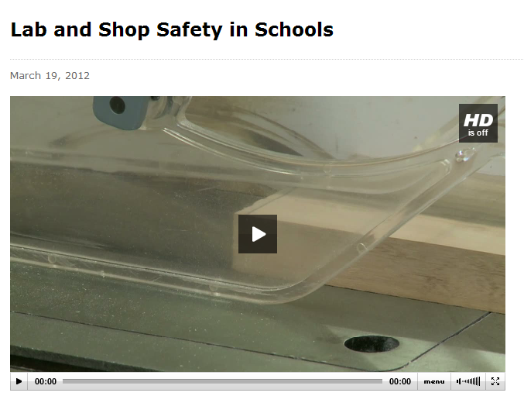
Recognizing Hazards
A Ministry of Labour Inspection
Click to link to video
Notes:
Link to video:
http://www.labour.gov.on.ca/english/gallery/v_schools_hs.php

Slide 61
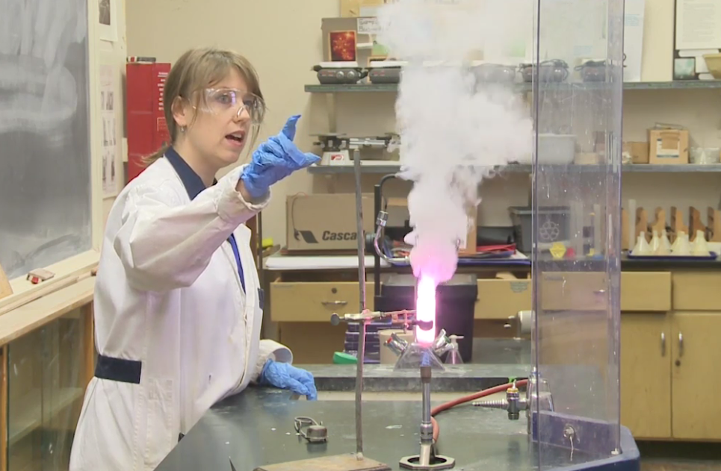
Hazards and Controls in the Gummy Bear Demo
Notes:
What are the hazards in this activity and how are they being controlled?

Slide 62

Program Resources

Slide 63

Program Resources

Slide 64

Program Resources
Notes:
Pause to allow time to look at the docs

Slide 65
Program Resource Documents
Common Elements
  Shared Understanding and Sample Discussion Questions
  Safety Checklists
Purpose
  To facilitate an open and collaborative discussion between teacher and principal during facility visits

Slide 66
Benefits of eLearning
Just in time (available 24/7)
Self-paced
Increased retention
Consistent delivery
Green
Significant return on investment

Slide 67
Grades 7 and 8 Science and Technology
Click to start module
Notes:
http://pshsa.ca/eLearningAssets/CODE/drafts/sc78/Student%20Safety%20in%20Elementary%20Science%20and%20Technology%20Grade%207%20and%208%20output/story.html

Slide 68

Safety Checklists
Purpose:
To provide a sample set of look fors during your visits
Initiate a frank and collaborative “safety mindedness” discussion with teachers

Slide 69
Sample “Look Fors”

Slide 70
Secondary Technological Education
Click to start module
Notes:
http://pshsa.ca/eLearningAssets/CODE/drafts/tech/Student%20Safety%20in%20Secondary%20Technological%20Education%20Grades%209%20to%2012%20output/story.html

Slide 71
Science 9-12 Sample “Look Fors”

Slide 72
Safer Alternatives: Reduce Concentrations
e.g., Elephant Toothpaste Demo
Chemical: Hydrogen peroxide
Choice of concentration:
30% or 6%
Click to link to video
Notes:
https://www.youtube.com/watch?v=x8gVIzRJ-J0

Slide 73
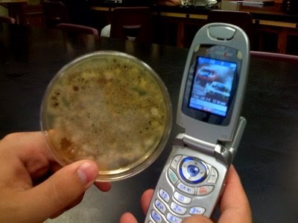

Safer Alternatives: Cultures
STAO/APSO recommends:
“Do not grow cultures of spores collected from environmental surfaces, e.g., telephones, door knobs, and washrooms, etc.” - Safe ON Science p. 46
Culture known organisms purchased from approved vendors

Slide 74
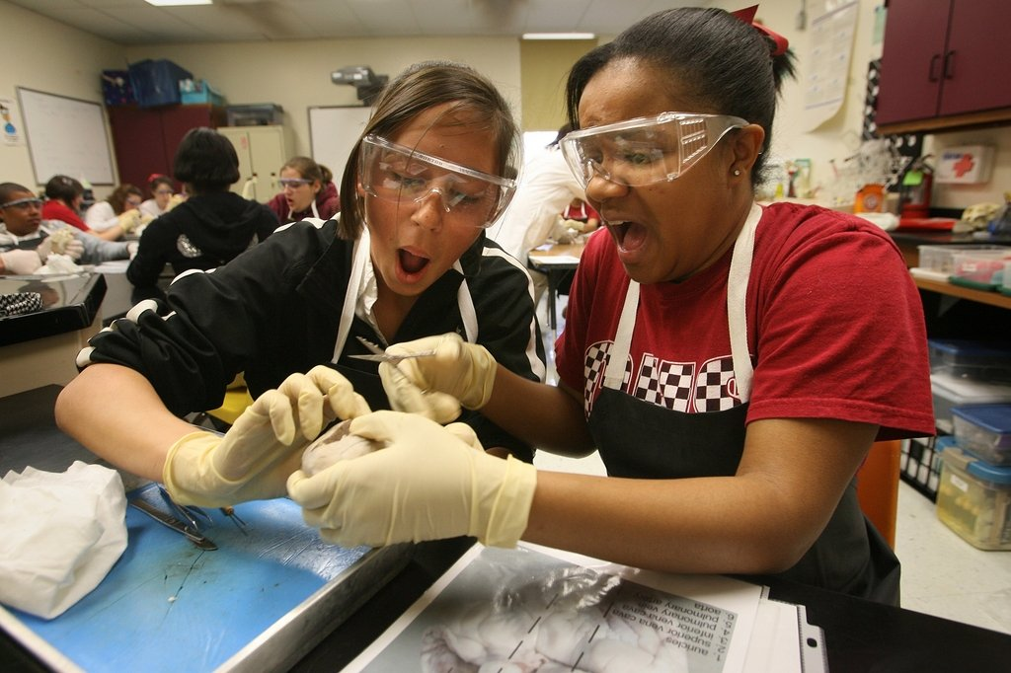
Safer Alternatives: Dissections
Hazards?
Notes:
What are the hazards in a typical dissection? How are they controlled?

Slide 75
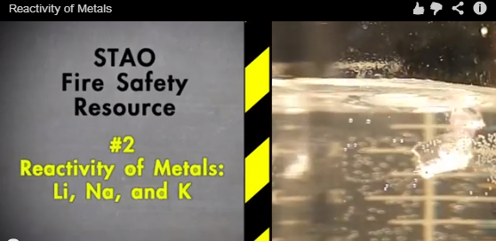
Sample STAO Fire Safety Video
  Reactivity of Metals – Li, Na, and K
Click to link to video
Notes:
http://stao.ca/res2/firevid2.php
A sample video from the set of 6 STAO Fire Safety Videos

Slide 76
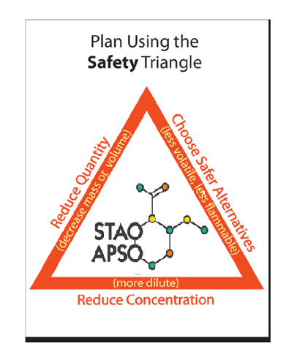
Risk Management Advice from the Fire Safety Videos
  Check that the activity aligns with the curriculum
  Use the smallest possible quantity/volume of a chemical
  Use lower/safer concentrations of reagents
  Use safer alternatives if possible
  Use hot plates instead of open-flame burners
  Test the activity yourself ahead of time; consult experienced teachers
Notes:
This slide summarizes the main themes of STAO fire safety videos

Slide 77
Ontario Council of Technology Education (OCTE) - Resources
2010-11 – Financial literacy lessons for 8 Broad Based Technology Programs on the EduGains website; 2012 – Safety lessons posted on the OCTE SafetyNET website; 2013 – Currently updating all existing OCTE SafeDOCS to align to all technological education programs Developed in partnership and funding from Ministry of Education

Slide 78
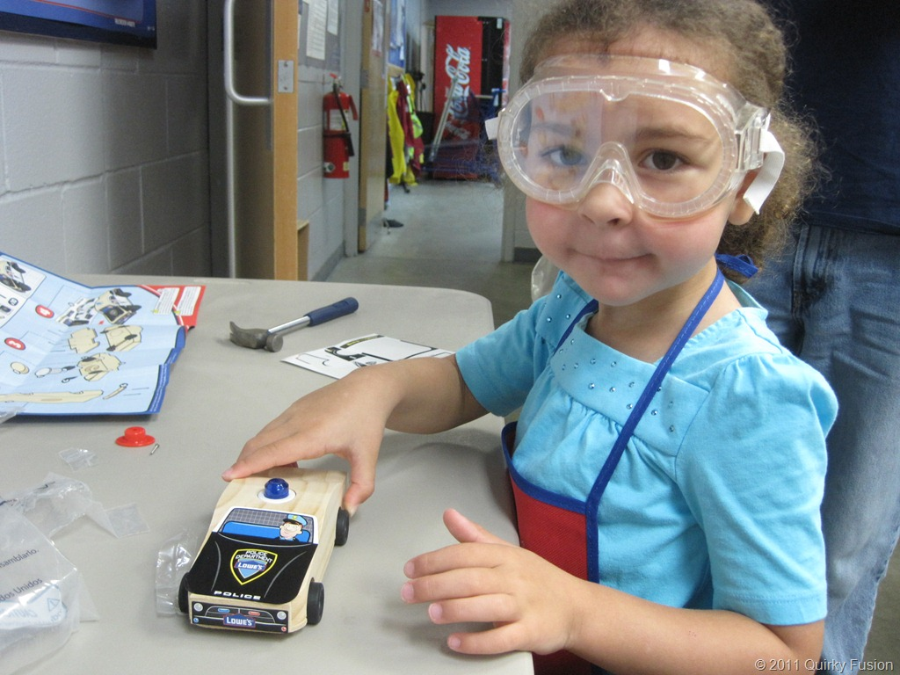
Safety Mindedness:
An Attitude for Life

